Slide 1

Saz Enterprises
By Sibtain
Asad
Zain

Slide 2
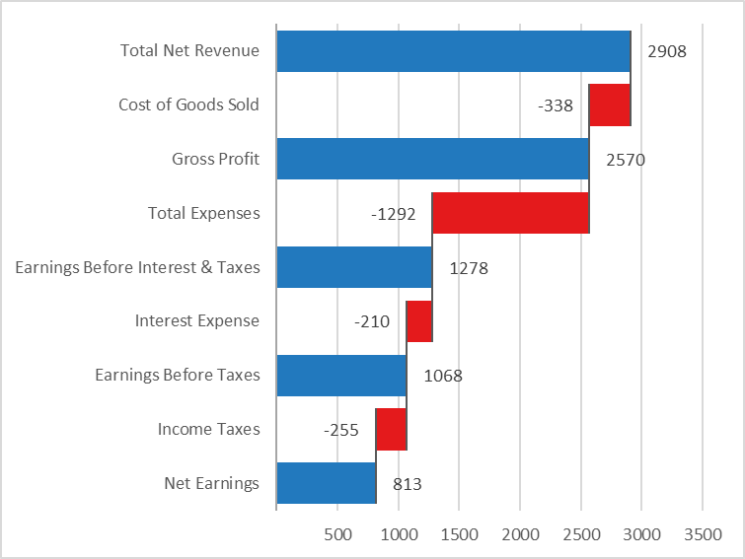
Stats Of The Whole Year

Slide 3

Formulas
Total Net Revenue
Definition: Income from sales or services after discounts and returns.
Formula:
Net Revenue=Gross Sales−Returns
Purpose: Shows total money earned from operations.
Cost of Goods Sold (COGS)
Definition: Direct cost of producing goods or services sold.
Formula:
COGS=Opening Inventory + Purchases− Closing Inventory
Includes: Raw materials, direct labor, production costs.
Gross Profit
Definition: Profit before operating costs.
Formula:
Gross Profit=Net Revenue−COGS
Purpose: Measures profitability of core activities.

Slide 4

Formulas
Total Expenses
Definition: All operating costs except COGS.
Common Elements:
Wages & Salaries
Marketing & Advertising
Rent & Utilities
Depreciation
Outsourced Services
EBIT (Earnings Before Interest & Taxes)
Definition: Profit from operations before financing and taxes.
Formula:
EBIT=Gross Profit−Operating Expenses
Also Known As: Operating Income
Interest Expense
Definition: Cost of borrowing funds.
Why It Matters: Represents financing cost, not part of core operations.
Income Taxes
Formula:
Income Tax=EBT × Tax Rate
Note: Depends on applicable corporate tax laws.
Net Earnings
Definition: Final profit after all costs, interest, and taxes.
Formula:
Net Earnings=EBT−Income Taxes
Also Known As: Net Profit or Net Income
Earnings Before Tax (EBT)
Formula:
EBT=EBIT−Interest Expense
Purpose: Profit before tax obligations are applied.

Slide 5

Conclusion
🔸 Visual Insight from the Chart
Illustrates the value flow from Revenue to Net Earnings.
It shows how each cost and expense reduces the top-line revenue.
The relatively small drop from EBIT to Net Earnings implies good tax and interest control.
🟢 Summary Conclusion:
Profitability is strong.
Operational efficiency has improved.
Revenue growth and cost savings are both contributing positively.
Minor concern: monitor interest expenses if they continue to rise.

Slide 6

THANK YOU

